Slide 1
Virtual Memory Management

Slide 2
Virtual memory
Consider a typical, large application:
  There are many components that are mutually exclusive. Example: A unique function selected dependent on user choice.
  Error routines and exception handlers are very rarely used.
  Most programs exhibit a slowly changing locality of reference. There are two types of locality: spatial and temporal.

Slide 3
Characteristics of Paging and Segmentation
Memory references are dynamically translated into physical addresses at run time
  a process may be swapped in and out of main memory such that it occupies different regions
A process may be broken up into pieces (pages or segments) that do not need to be located contiguously in main memory
Hence: all pieces of a process do not need to be loaded in main memory during execution
  computation may proceed for some time if the next instruction to be fetch (or the next data to be accessed) is in a piece located in main memory

Slide 4
Process Execution
The OS brings into main memory only a few pieces of the program (including its starting point)
Each page/segment table entry has a present bit that is set only if the corresponding piece is in main memory
The resident set is the portion of the process that is in main memory
An interrupt (memory fault) is generated when the memory reference is on a piece not present in main memory

Slide 5
Process Execution (cont.)
OS places the process in a Blocking state
OS issues a disk I/O Read request to bring into main memory the piece referenced to
another process is dispatched to run while the disk I/O takes place
an interrupt is issued when the disk I/O completes
  this causes the OS to place the affected process in the Ready state

Slide 6
Advantages of Partial Loading
More processes can be maintained in main memory
  only load in some of the pieces of each process
  With more processes in main memory, it is more likely that a process will be in the Ready state at any given time
A process can now execute even if it is larger than the main memory size
  it is even possible to use more bits for logical addresses than the bits needed for addressing the physical memory

Slide 7
Virtual Memory: large as you wish!
  Ex: 16 bits are needed to address a physical memory of 64KB
  lets use a page size of 1KB so that 10 bits are needed for offsets within a page
  For the page number part of a logical address we may use a number of bits larger than 6, say 22 (a modest value!!)
The memory referenced by a logical address is called virtual memory
  is maintained on secondary memory (ex: disk)
  pieces are bring into main memory only when needed

Slide 8
Virtual Memory (cont.)
  For better performance, the file system is often bypassed and virtual memory is stored in a special area of the disk called the swap space
    larger blocks are used and file lookups and indirect allocation methods are not used
By contrast, physical memory is the memory referenced by a physical address
  is located on DRAM
The translation from logical address to physical address is done by indexing the appropriate page/segment table with the help of memory management hardware

Slide 9
Possibility of trashing
To accommodate as many processes as possible, only a few pieces of each process is maintained in main memory
But main memory may be full: when the OS brings one piece in, it must swap one piece out
The OS must not swap out a piece of a process just before that piece is needed
If it does this too often this leads to trashing:
  The processor spends most of its time swapping pieces rather than executing user instructions

Slide 10
Locality
Temporal locality: Addresses that are referenced at some time Ts will be accessed in the near future (Ts + delta_time) with high probability. Example : Execution in a loop.
Spatial locality: Items whose addresses are near one another tend to be referenced close together in time. Example: Accessing array elements.
How can we exploit this characteristics of programs? Keep only the current locality in the main memory. Need not keep the entire program in the main memory.

Slide 11
Locality and Virtual Memory
Principle of locality of references: memory references within a process tend to cluster
Hence: only a few pieces of a process will be needed over a short period of time
Possible to make intelligent guesses about which pieces will be needed in the future
This suggests that virtual memory may work efficiently (ie: trashing should not occur too often)

Slide 12
Space and Time
CPU
cache
Main
memory
Secondary
Storage
Cost/byte
Storage capacity
Desirable
Access time
increasing

Slide 13
Demand paging
Main memory (physical address space) as well as user address space (virtual address space) are logically partitioned into equal chunks known as pages. Main memory pages (sometimes known as frames) and virtual memory pages are of the same size.
Virtual address (VA) is viewed as a pair (virtual page number, offset within the page). Example: Consider a virtual space of 16K , with 2K page size and an address 3045. What the virtual page number and offset corresponding to this VA?

Slide 14
Virtual Page Number and Offset
3045 / 2048 = 1
3045 % 2048 = 3045 - 2048 = 997
VP# = 1
Offset within page = 997
Page Size is always a power of 2? Why?

Slide 15
Page Size Criteria
Consider the binary value of address 3045 :
1011 1110 0101
for 16K address space the address will be 14 bits. Rewrite:
00 1011 1110 0101
A 2K address space will have offset range 0 -2047 (11 bits)
001
011 1110 0101
Page#
Offset within page

Slide 16
Demand paging (contd.)
There is only one physical address space but as many virtual address spaces as the number of processes in the system. At any time physical memory may contain pages from many process address space.
Pages are brought into the main memory when needed and “rolled out” depending on a page replacement policy.
Consider a 8K main (physical) memory and three virtual address spaces of 2K, 3K and 4K each. Page size of 1K. The status of the memory mapping at some time is as shown.

Slide 17
Demand Paging (contd.)
Executable
code space
0
1
2
3
LAS 0
4
5
6
7
LAS 1
Main memory
(Physical Address Space -PAS)
LAS 2
LAS - Logical Address Space

Slide 18
Issues in demand paging
How to keep track of which logical page goes where in the main memory? More specifically, what are the data structures needed?
  Page table, one per logical address space.
How to translate logical address into physical address and when?
  Address translation algorithm applied every time a memory reference is needed.
How to avoid repeated translations?
  After all most programs exhibit good locality. “cache recent translations”

Slide 19
Issues in demand paging (contd.)
What if main memory is full and your process demands a new page? What is the policy for page replacement? LRU, MRU, FIFO, random?
Do we need to roll out every page that goes into main memory? No, only the ones that are modified. How to keep track of this info and such other memory management information? In the page table as special bits.

Slide 20
Support Needed for
Virtual Memory
Memory management hardware must support paging and/or segmentation
OS must be able to manage the movement of pages and/or segments between secondary memory and main memory
We will first discuss the hardware aspects; then the algorithms used by the OS

Slide 21
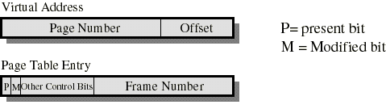
Paging
Typically, each process has its own page table
Each page table entry contains a present bit to indicate whether the page is in main memory or not.
  If it is in main memory, the entry contains the frame number of the corresponding page in main memory
  If it is not in main memory, the entry may contain the address of that page on disk or the page number may be used to index another table (often in the PCB) to obtain the address of that page on disk

Slide 22
Paging
A modified bit indicates if the page has been altered since it was last loaded into main memory
  If no change has been made, the page does not have to be written to the disk when it needs to be swapped out
Other control bits may be present if protection is managed at the page level
  a read-only/read-write bit
  protection level bit: kernel page or user page (more bits are used when the processor supports more than 2 protection levels)

Slide 23
Page Table Structure
Page tables are variable in length (depends on process size)
  then must be in main memory instead of registers
A single register holds the starting physical address of the page table of the currently running process

Slide 24
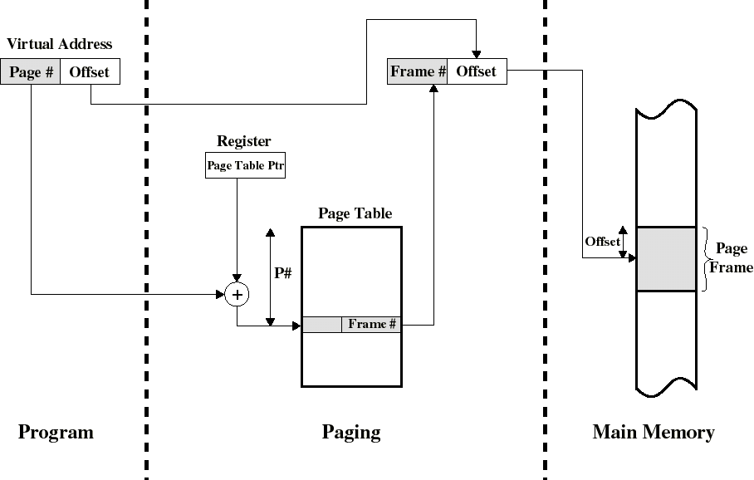
Address Translation in a Paging System

Slide 25
Sharing Pages
If we share the same code among different users, it is sufficient to keep only one copy in main memory
Shared code must be reentrant (ie: non self-modifying) so that 2 or more processes can execute the same code
If we use paging, each sharing process will have a page table who’s entry points to the same frames: only one copy is in main memory
But each user needs to have its own private data pages

Slide 26
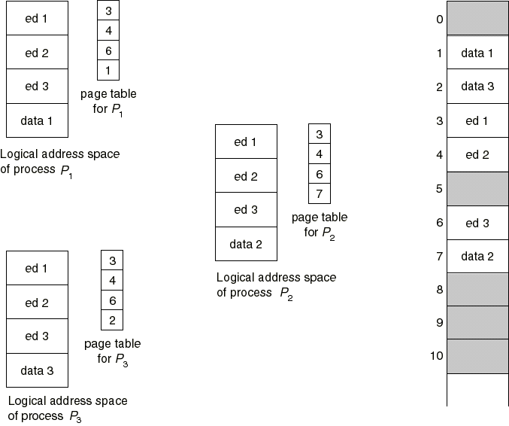
Sharing Pages: a text editor

Slide 27
Translation Lookaside Buffer
Because the page table is in main memory, each virtual memory reference causes at least two physical memory accesses
  one to fetch the page table entry
  one to fetch the data
To overcome this problem a special cache is set up for page table entries
  called the TLB - Translation Lookaside Buffer
    Contains page table entries that have been most recently used
    Works similar to main memory cache

Slide 28
Translation Lookaside Buffer
Given a logical address, the processor examines the TLB
If page table entry is present (a hit), the frame number is retrieved and the real (physical) address is formed
If page table entry is not found in the TLB (a miss), the page number is used to index the process page table
  if present bit is set then the corresponding frame is accessed
  if not, a page fault is issued to bring in the referenced page in main memory
The TLB is updated to include the new page entry

Slide 29
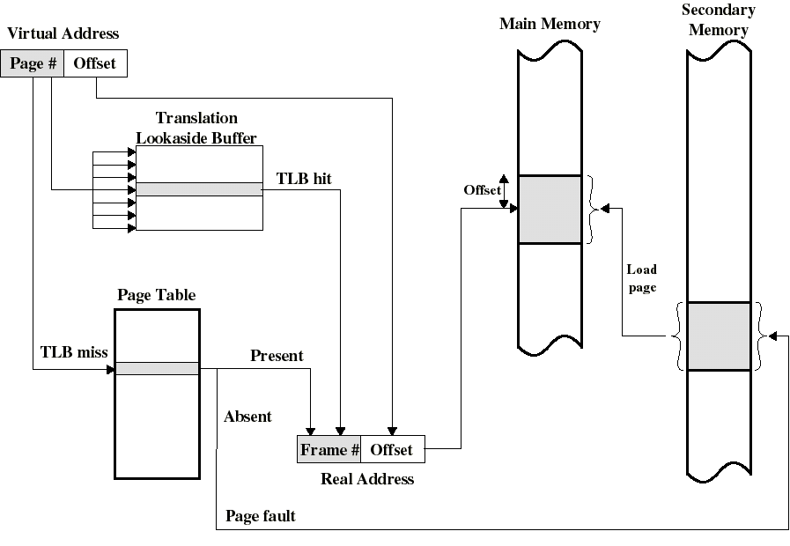
Use of a Translation Lookaside Buffer

Slide 30
TLB: further comments
TLB use associative mapping hardware to simultaneously interrogates all TLB entries to find a match on page number
The TLB must be flushed each time a new process enters the Running state
The CPU uses two levels of cache on each virtual memory reference
  first the TLB: to convert the logical address to the physical address
  once the physical address is formed, the CPU then looks in the cache for the referenced word

Slide 31
Page Tables and Virtual Memory
Most computer systems support a very large virtual address space
  32 to 64 bits are used for logical addresses
  If (only) 32 bits are used with 4KB pages, a page table may have 2^{20} entries
The entire page table may take up too much main memory. Hence, page tables are often also stored in virtual memory and subjected to paging
  When a process is running, part of its page table must be in main memory (including the page table entry of the currently executing page)

Slide 32
Inverted Page Table
Another solution (PowerPC, IBM Risk 6000) to the problem of maintaining large page tables is to use an Inverted Page Table (IPT)
We generally have only one IPT for the whole system
There is only one IPT entry per physical frame (rather than one per virtual page)
  this reduces a lot the amount of memory needed for page tables
The 1st entry of the IPT is for frame #1 ... the nth entry of the IPT is for frame #n and each of these entries contains the virtual page number
Thus this table is inverted

Slide 33
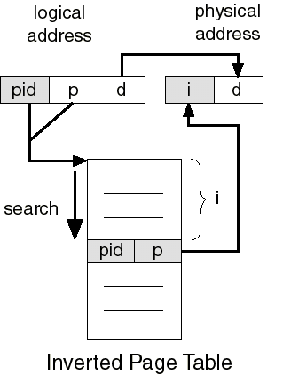
Inverted Page Table
The process ID with the virtual page number could be used to search the IPT to obtain the frame #
For better performance, hashing is used to obtain a hash table entry which points to a IPT entry
  A page fault occurs if no match is found
  chaining is used to manage hashing overflow
d = offset within page

Slide 34
The Page Size Issue
Page size is defined by hardware; always a power of 2 for more efficient logical to physical address translation. But exactly which size to use is a difficult question:
  Large page size is good since for a small page size, more pages are required per process
    More pages per process means larger page tables. Hence, a large portion of page tables in virtual memory
  Small page size is good to minimize internal fragmentation
  Large page size is good since disks are designed to efficiently transfer large blocks of data
  Larger page sizes means less pages in main memory; this increases the TLB hit ratio

Slide 35
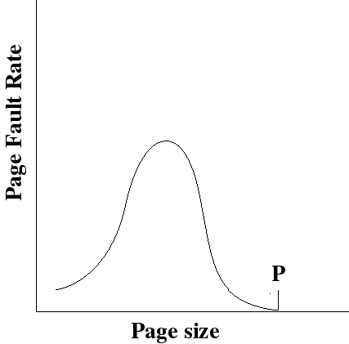
The Page Size Issue
With a very small page size, each page matches the code that is actually used: faults are low
Increased page size causes each page to contain more code that is not used. Page faults rise.
Page faults decrease if we can approach point P were the size of a page is equal to the size of the entire process

Slide 36
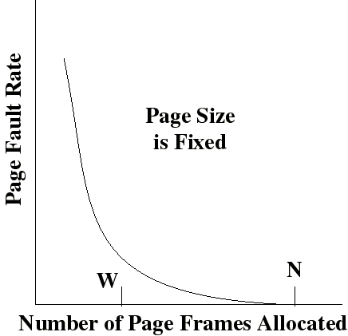
The Page Size Issue
Page fault rate is also determined by the number of frames allocated per process
Page faults drops to a reasonable value when W frames are allocated
Drops to 0 when the number (N) of frames is such that a process is entirely in memory

Slide 37
The Page Size Issue
Page sizes from 1KB to 4KB are most commonly used
But the issue is non trivial. Hence some processors are now supporting multiple page sizes. Ex:
  Pentium supports 2 sizes: 4KB or 4MB
  R4000 supports 7 sizes: 4KB to 16MB

Slide 38
Operating System Software
Memory management software depends on whether the hardware supports paging or segmentation or both
Pure segmentation systems are rare. Segments are usually paged -- memory management issues are then those of paging
We shall thus concentrate on issues associated with paging
To achieve good performance we need a low page fault rate

Slide 39
Fetch Policy
Determines when a page should be brought into main memory. Two common policies:
  Demand paging only brings pages into main memory when a reference is made to a location on the page (ie: paging on demand only)
    many page faults when process first started but should decrease as more pages are brought in
  Prepaging brings in more pages than needed
    locality of references suggest that it is more efficient to bring in pages that reside contiguously on the disk
    efficiency not definitely established: the extra pages brought in are “often” not referenced

Slide 40
Placement policy
Determines where in real memory a process piece resides
For pure segmentation systems:
  first-fit, next fit... are possible choices (a real issue)
For paging (and paged segmentation):
  the hardware decides where to place the page: the chosen frame location is irrelevant since all memory frames are equivalent (not an issue)

Slide 41
Replacement Policy
Deals with the selection of a page in main memory to be replaced when a new page is brought in
This occurs whenever main memory is full (no free frame available)
Occurs often since the OS tries to bring into main memory as many processes as it can to increase the multiprogramming level

Slide 42
Replacement Policy
Not all pages in main memory can be selected for replacement
Some frames are locked (cannot be paged out):
  much of the kernel is held on locked frames as well as key control structures and I/O buffers
The OS might decide that the set of pages considered for replacement should be:
  limited to those of the process that has suffered the page fault
  the set of all pages in unlocked frames

Slide 43
Replacement Policy
The decision for the set of pages to be considered for replacement is related to the resident set management strategy:
  how many page frames are to be allocated to each process? We will discuss this later
No matter what is the set of pages considered for replacement, the replacement policy deals with algorithms that will choose the page within that set

Slide 44
Basic algorithms for the replacement policy
The Optimal policy selects for replacement the page for which the time to the next reference is the longest
  produces the fewest number of page faults
  impossible to implement (need to know the future) but serves as a standard to compare with the other algorithms we shall study:
    Least recently used (LRU)
    First-in, first-out (FIFO)
    Clock

Slide 45
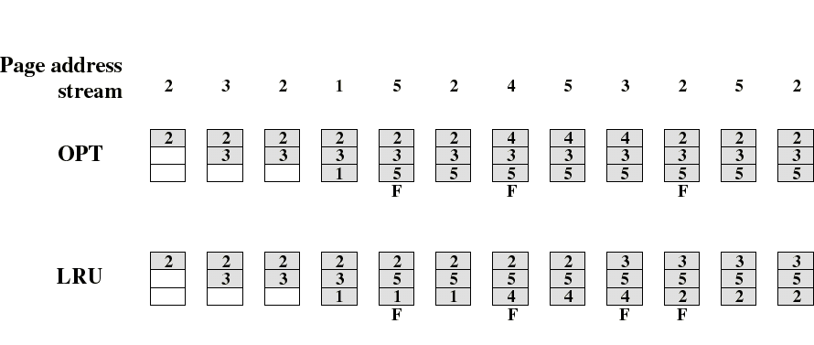
The LRU Policy
Replaces the page that has not been referenced for the longest time
  By the principle of locality, this should be the page least likely to be referenced in the near future
  performs nearly as well as the optimal policy
Example: A process of 5 pages with an OS that fixes the resident set size to 3

Slide 46
Note on counting page faults
When the main memory is empty, each new page we bring in is a result of a page fault
For the purpose of comparing the different algorithms, we are not counting these initial page faults
  because the number of these is the same for all algorithms
But, in contrast to what is shown in the figures, these initial references are really producing page faults

Slide 47
Implementation of the LRU Policy
Each page could be tagged (in the page table entry) with the time at each memory reference.
The LRU page is the one with the smallest time value (needs to be searched at each page fault)
This would require expensive hardware and a great deal of overhead.
Consequently very few computer systems provide sufficient hardware support for true LRU replacement policy
Other algorithms are used instead

Slide 48
The FIFO Policy
Treats page frames allocated to a process as a circular buffer
  When the buffer is full, the oldest page is replaced. Hence: first-in, first-out
    This is not necessarily the same as the LRU page
    A frequently used page is often the oldest, so it will be repeatedly paged out by FIFO
  Simple to implement
    requires only a pointer that circles through the page frames of the process

